Slide 1
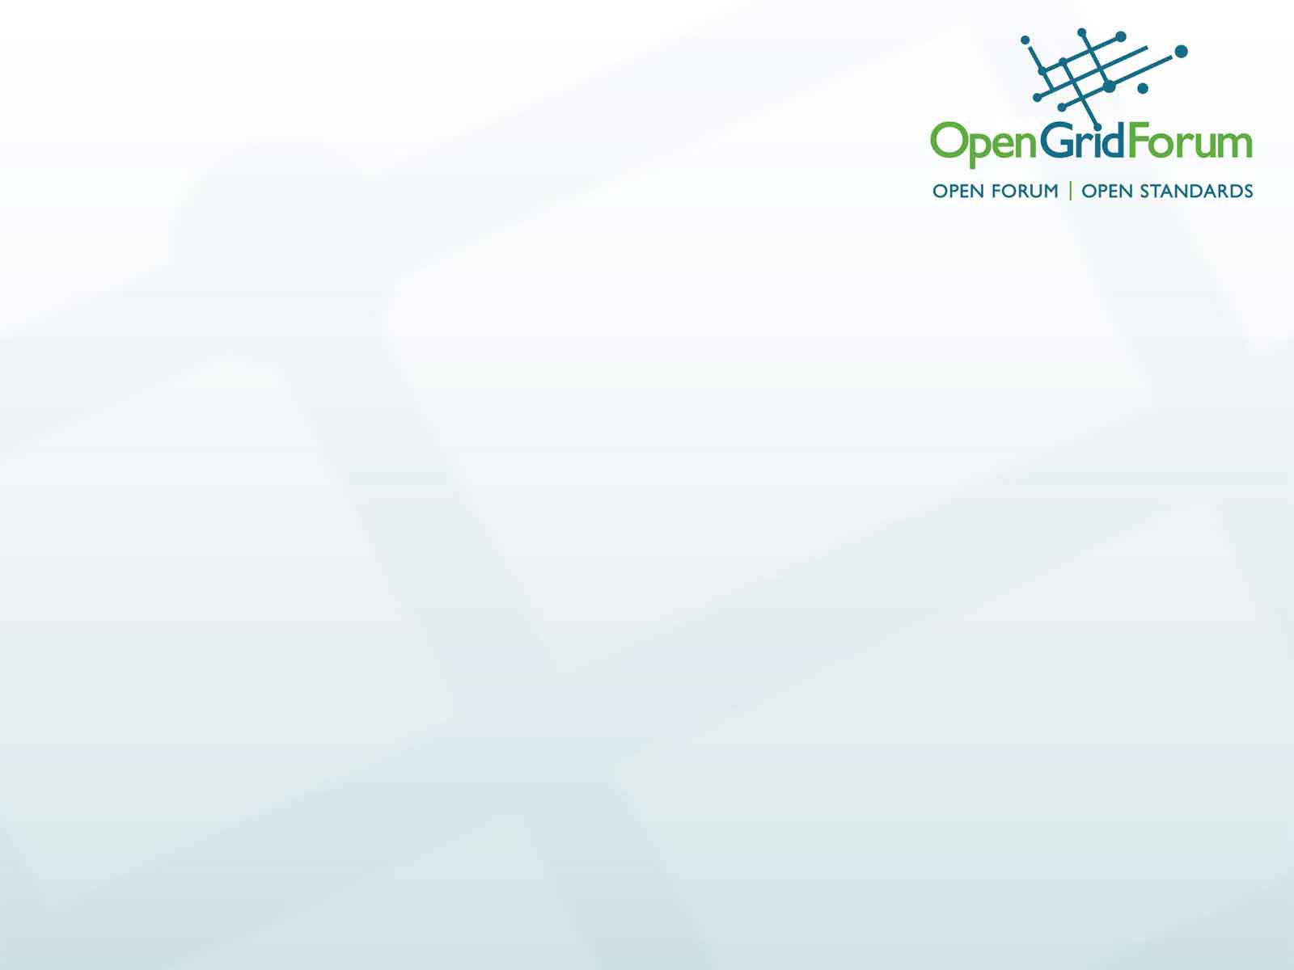
Topology Exchange Questions
NORDUnet, Uppsala
Freek Dijkstra, 22 Sep 2014

Slide 2
Two main questions
How to handle different policies for different users?
No policy distribution: every client sees the same topology
Policies are mentioned in the topology; every clients receives the same topology information.
Each neighbour may receive a custom topology. Redistribution to their neighbours is allowed.
Every client receives a custom topology. Redistribution is not allowed.
Are data plane and control plane congruent?
Same topology (in-band message exchange)
NSA neighbours may be different from data plane neighbours.

Slide 3
How to handle different policies for different users?
No policy distribution: every client sees the same topology.
Policies are enforced after a request is made, they are unknown beforehand
Users have little control which path is chosen; this may limit some business models (fees can be handled between (control plane) neighbours only)
Topology information is short, and can be redistributed
Policies are mentioned in the topology; every clients receives the same topology information.
May be generic policy only: e.g. 'transit allowed', 'local users only', 'need prior agreement for access’
Policy is made public
Topology information can be redistributed
Users have some control which path is chosen.
Each neighbour may receive a custom topology. Redistribution to their neighbours is allowed.
Users have limited control which path is chosen
This is very similar to how BGP works
Every client receives a custom topology. Redistribution is not allowed.
Topologies can't be distributed hop-by-hop (pointers can). Requires full mesh for distribution.
Most flexible, but least scalable option

Slide 4
Are data plane and control plane congruent?
Same topology
allows in-band distribution of topology or topology pointers
disallows tree model
can re-use local trust relations
NSA neighbours may be different from data plane neighbours
allows for brokers/proxy server, i.e. delegated control, such as common for virtual organisations (e.g. LHCONE)
allows tree model
requires third party PKI
Notes:
Chin: “The NSA signalling plane topology does not need to be congruent with data plane topology”

